Slide 1

Project Paperless
A smart solution for students and teachers

Slide 2
Members
TANZIM AL DIN AHMED
FAHAD BIN BARI SHOVO
SHAHADAT HOSSAIN PABEL
FAREHA ALAMGIR
SUMIYA NOORJAHAN

Slide 3
Overview

Slide 4
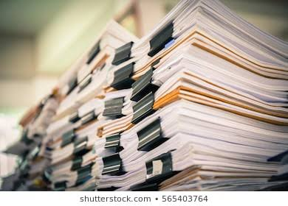
Overview
Every year a huge amount of paper is being used in Thesis/Report Submission in the Universities.
Most of which are discarded due to errors.
Become obsolete over time.
Or simply the owner loses track of them.
Increasing wastage of paper,
And also leads to increased Green House Gas Emissions that could be, otherwise, avoided.

Slide 5

Hypothesis
A system that manages these submissions and course materials online.
Reducing paper usage.
More efficient data management.
All in one place.
Less likely of losing important documents.
Environment Friendly.

Slide 6
Methodology

Slide 7
Methodology
Client-Server Architecture
Server
To ensure support across wide variety of devices
User Authentication
Provide with interface for easier content creation.
Perform Format, Plagiarism and Other Validations.
Students
Teachers
Submit thesis files online.
Create / Upload Course Materials.
View and verify submissions.
View uploaded course materials by the students.

Slide 8
Tools
Front – End
Back – End
HTML
CSS
JavaScript
Bootstrap4
CK Editor (Content Creation)
Wiris (Insert Equations)
MathJax (Display Math)
Ace Editor (Insert Code)
Python
Django (Python – Web Framework)
Python-docx (Word Document processing)
PyPDF2 (PDF Document processing)
PyLaTeX (Latex Document processing)

Slide 9
Features

Slide 10
Features
Front – End
Back – End
Register / Login Interface.
Thesis Upload Interface.
Course Content Design and Upload Interface.
Interface for viewing course contents.
Student Dashboards.
Teacher Dashboards.
**Responsive Layout for support across wide range of devices.
Authenticate Users.
Perform Plagiarism Checks.
Perform Format Checks.
Add Digital Signatures.
Store Documents and Course Contents.
Retrieve Documents and Course Contents.
Payment Methods.

Slide 11
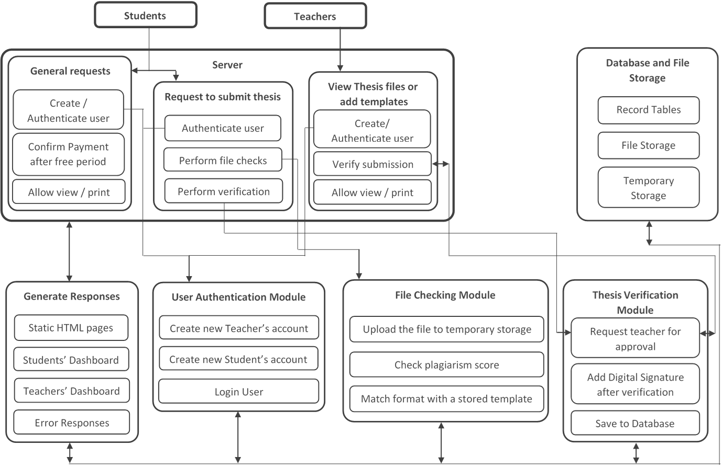
Detailed View

Slide 12
Recent Works

Slide 13
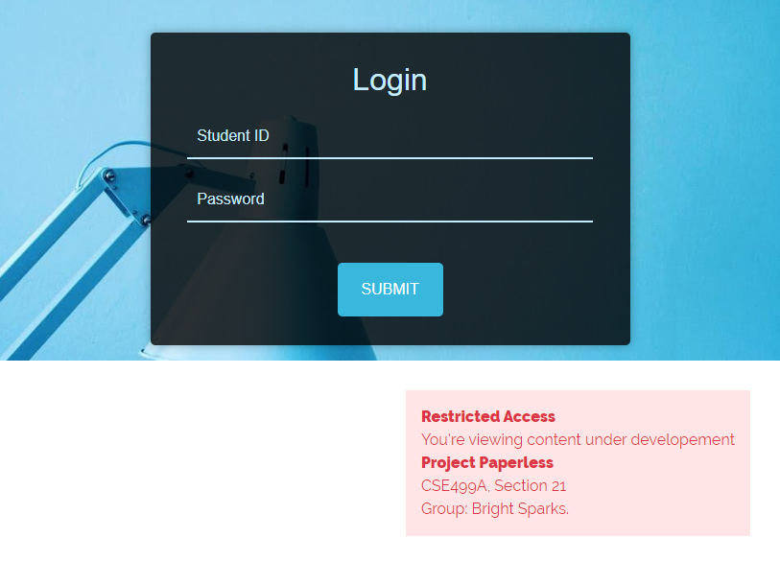
Login Page

Slide 14
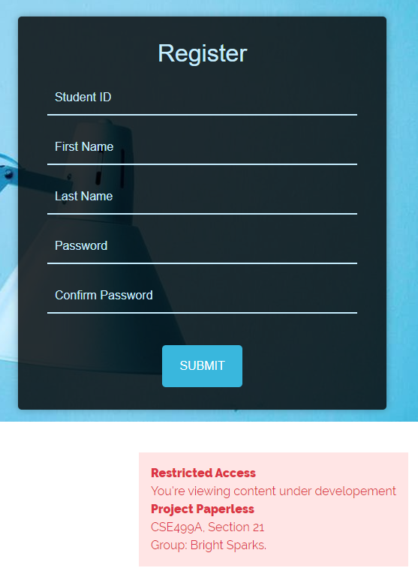
Register Page

Slide 15
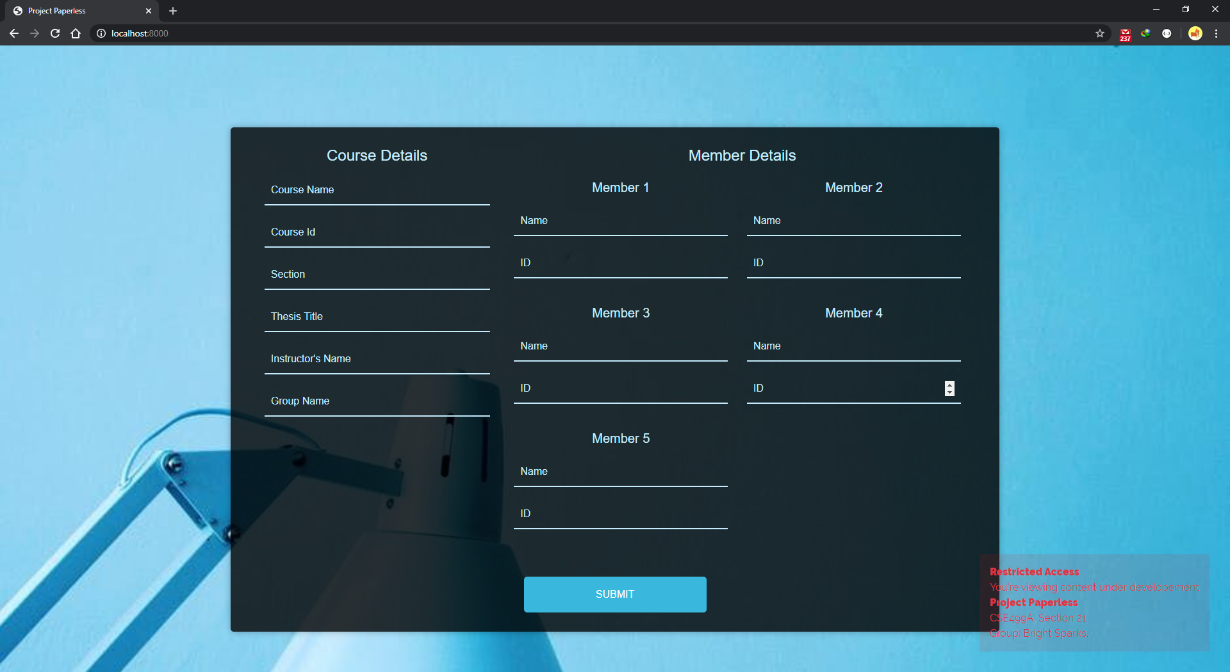
Generate Cover Page
From user inputs.

Slide 16
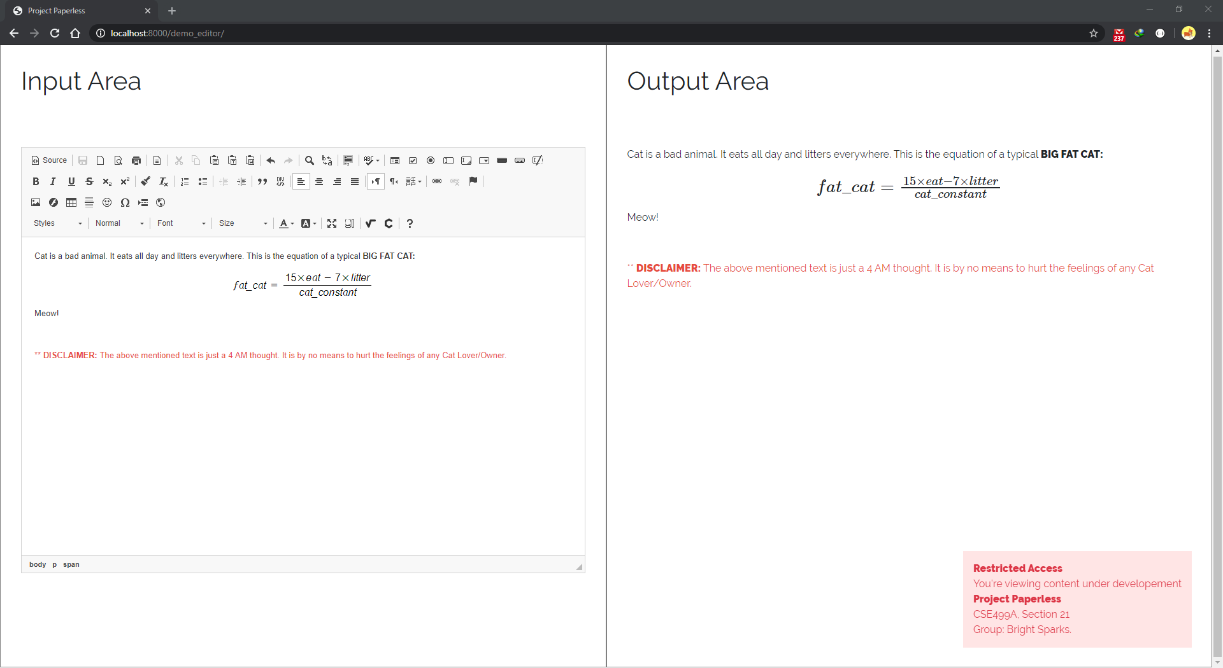
Content Creation Interface (Demo)

Slide 17
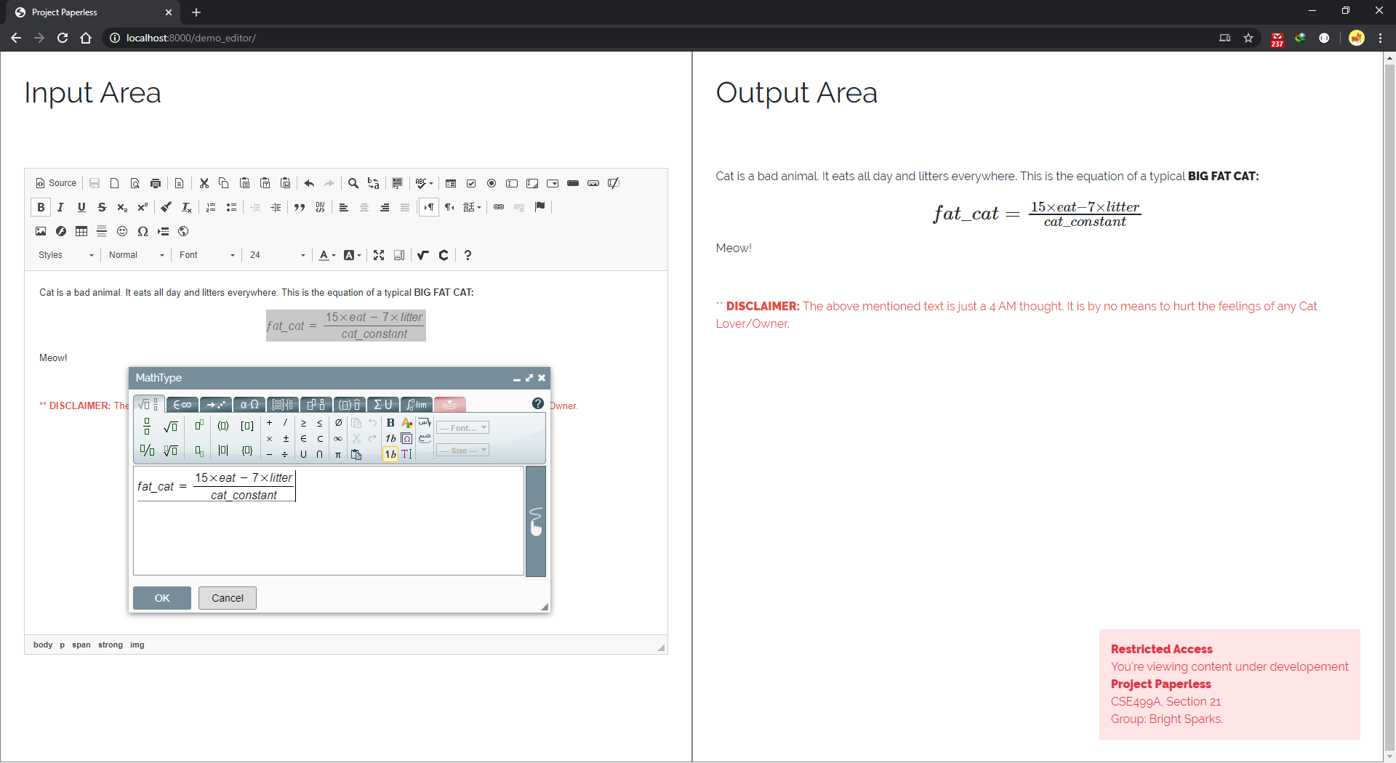
Content Creation Interface (Demo)

Slide 18

Happy New Year!

